Slide 1
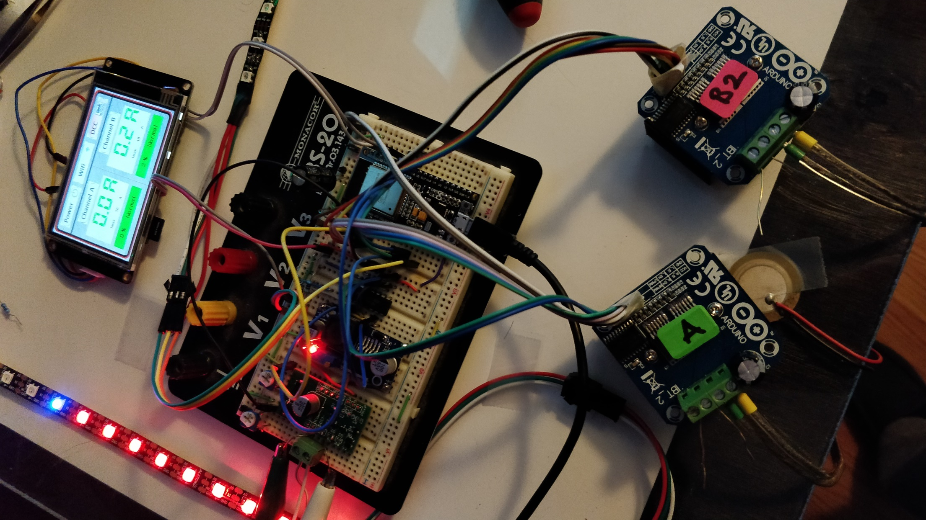
Holiday Booster
(Basic Research and Development Work)

Slide 2
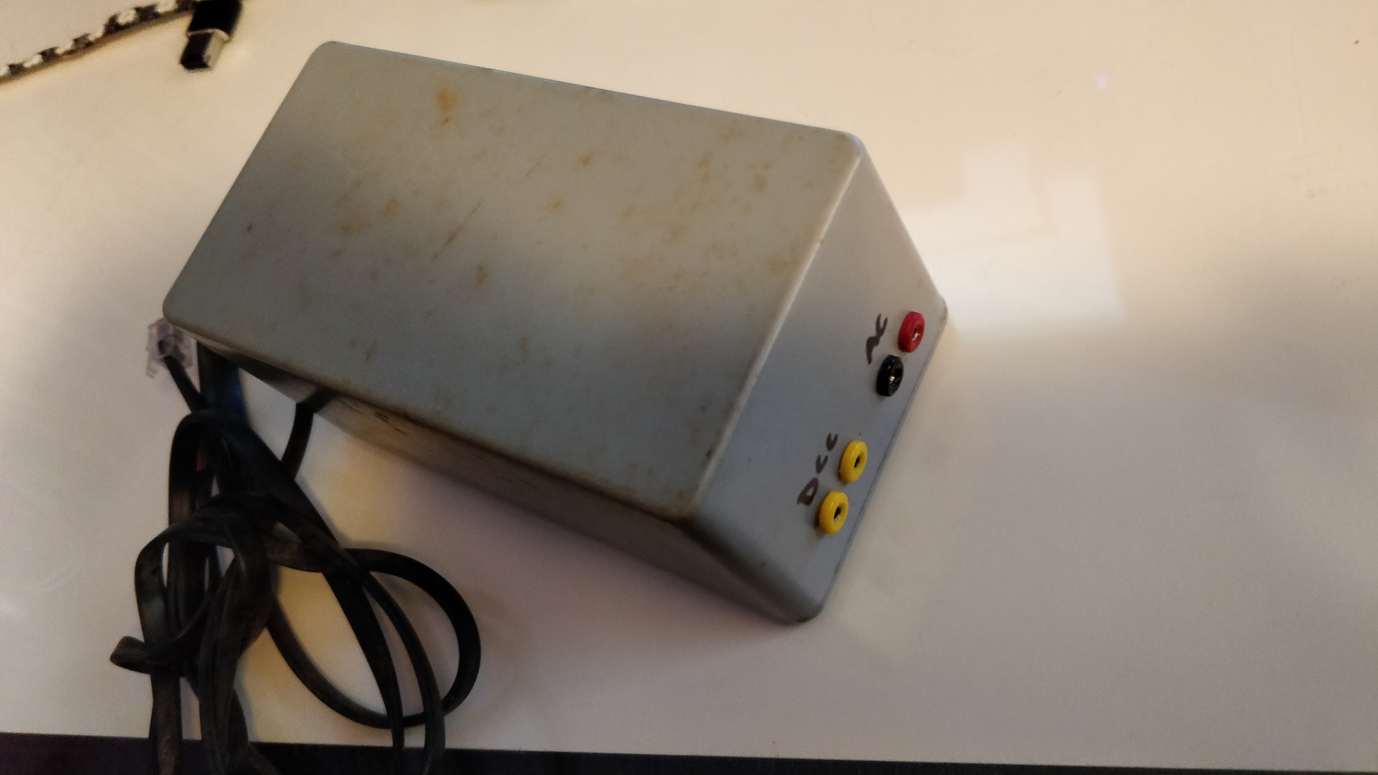

Slide 3
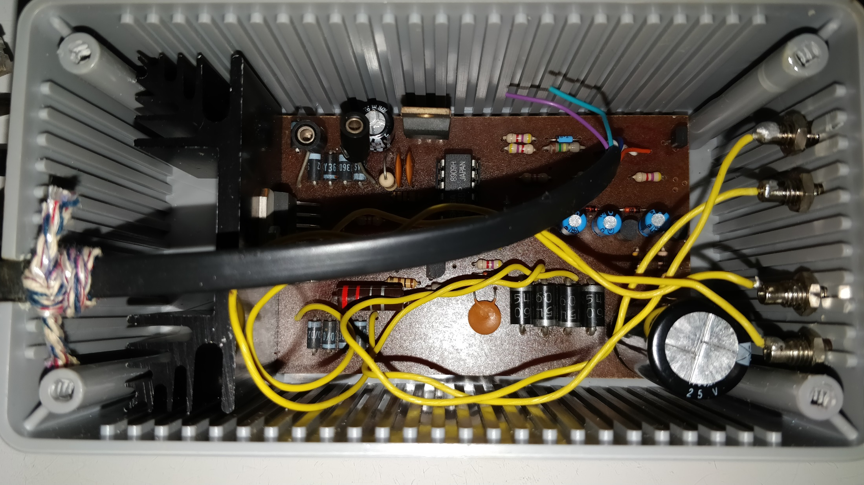

Slide 4
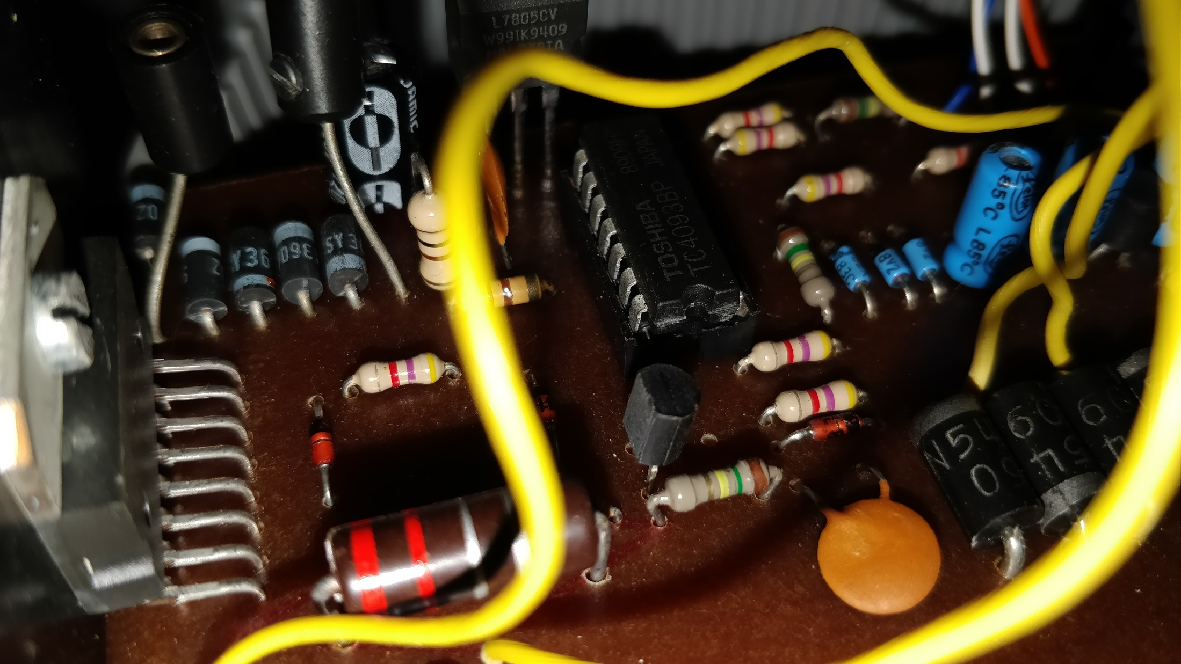

Slide 5
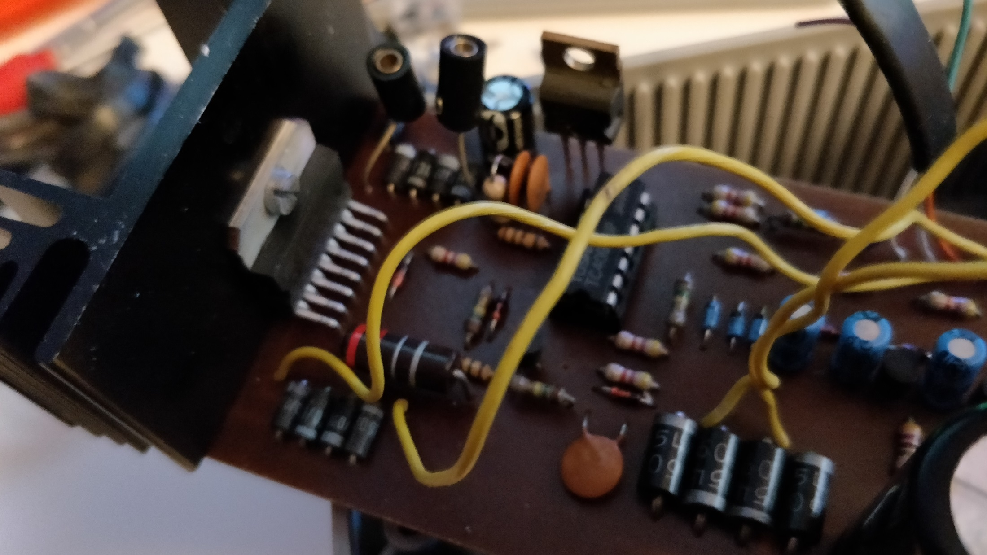
L298

Slide 6
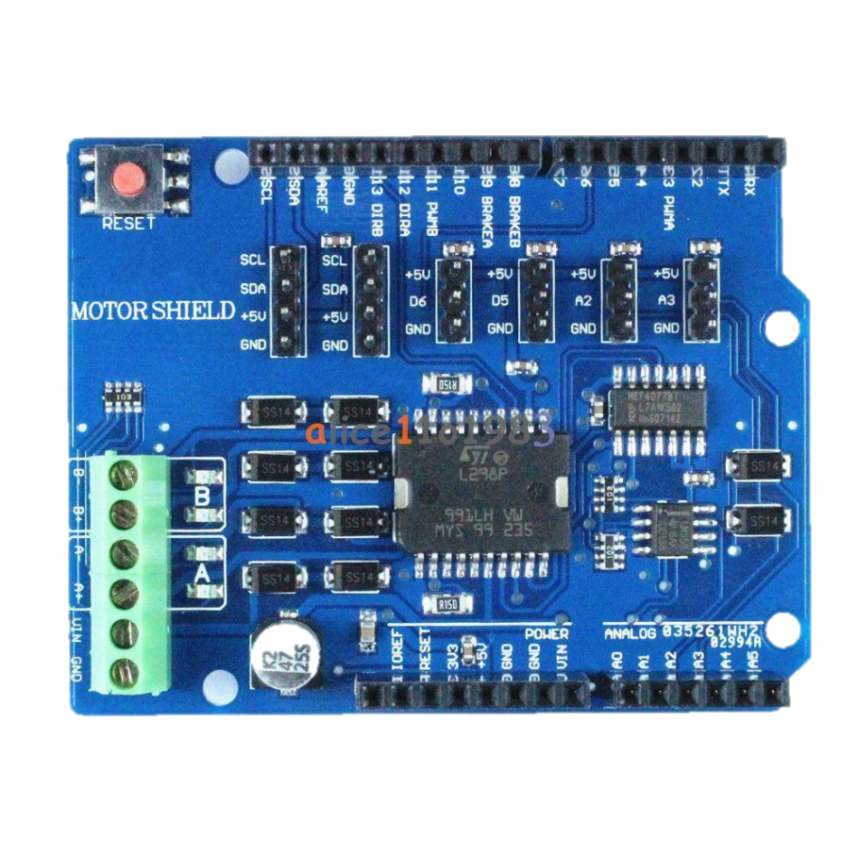
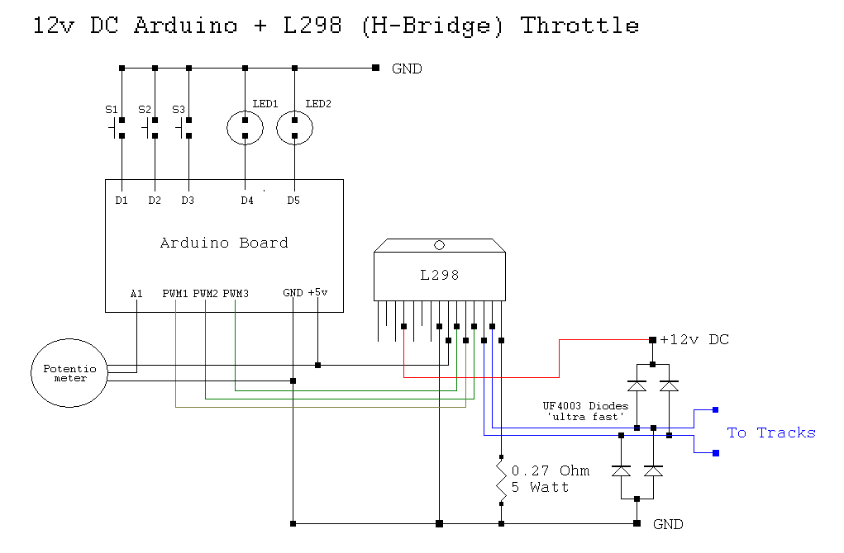
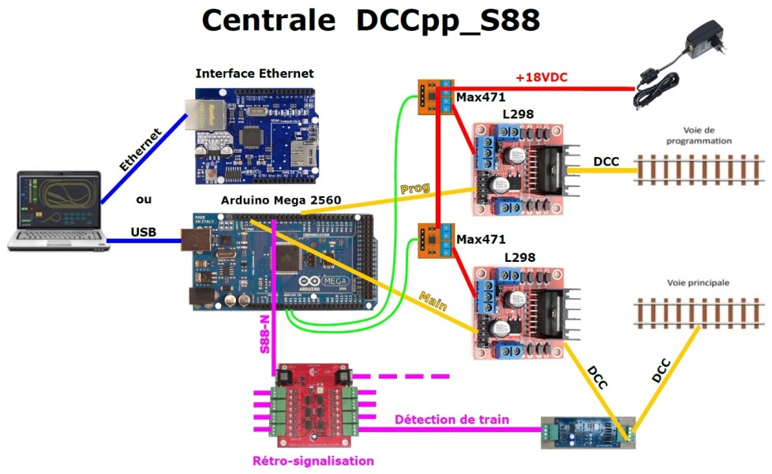
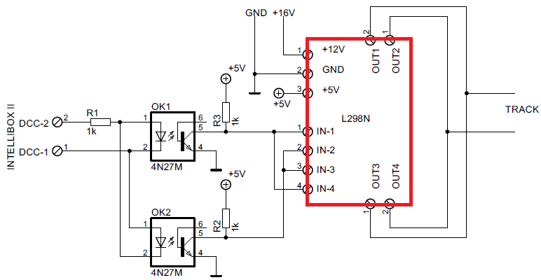
Source: Google Search for “L298 dcc booster”

Slide 7
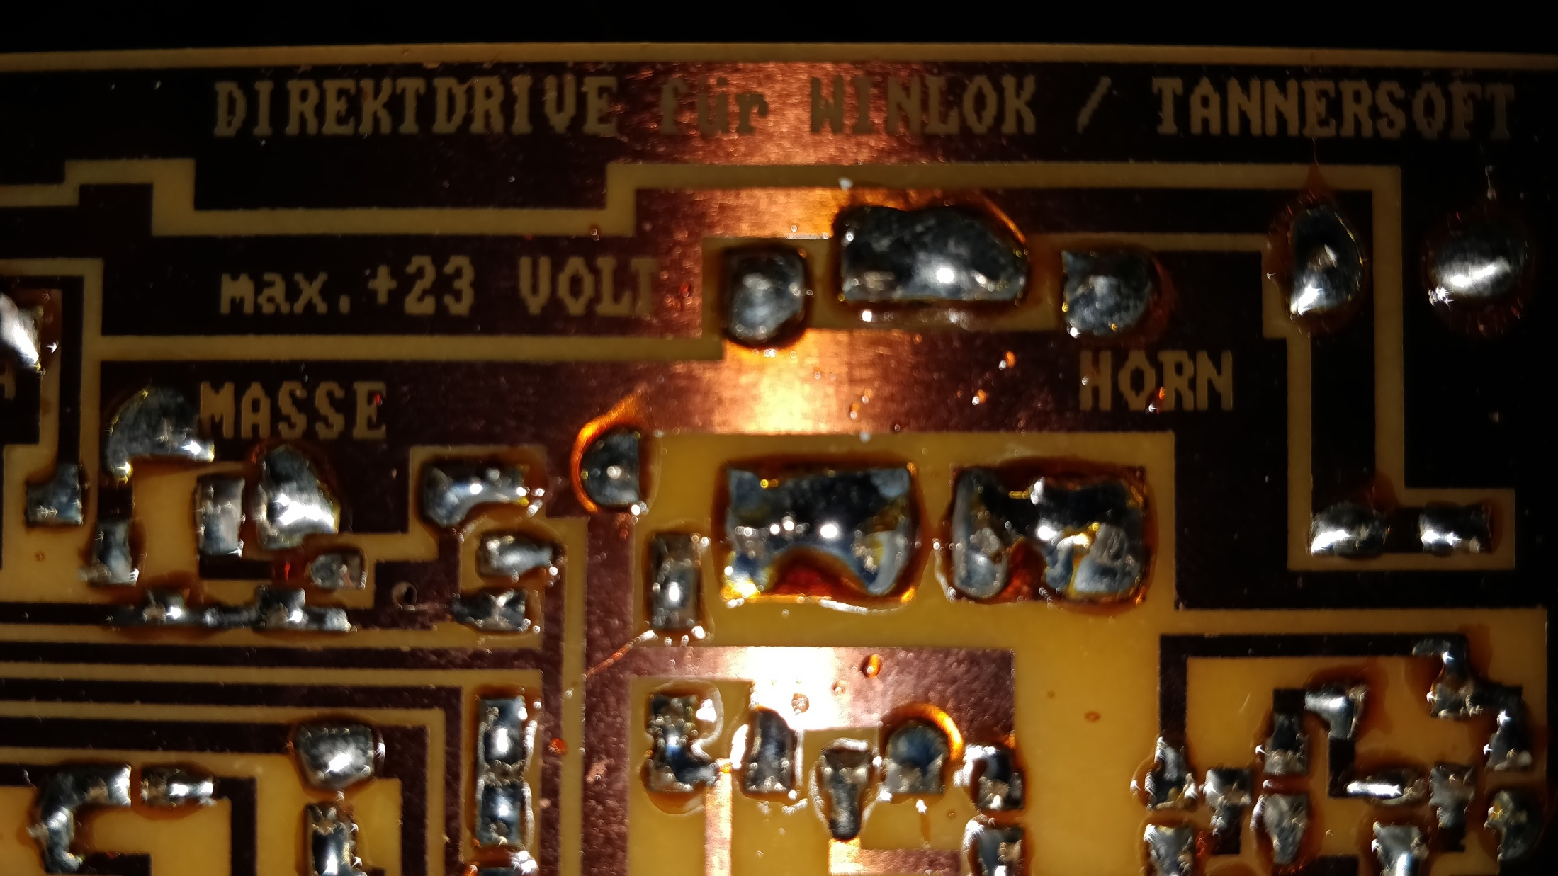

Slide 8

Some books written by Wolfgang Horn

Slide 10
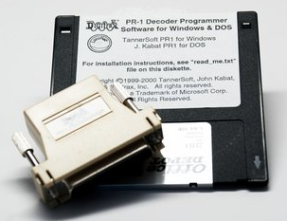
Source: http://www.digitrax.com/products/retired/computer-control/pr1/

Slide 11
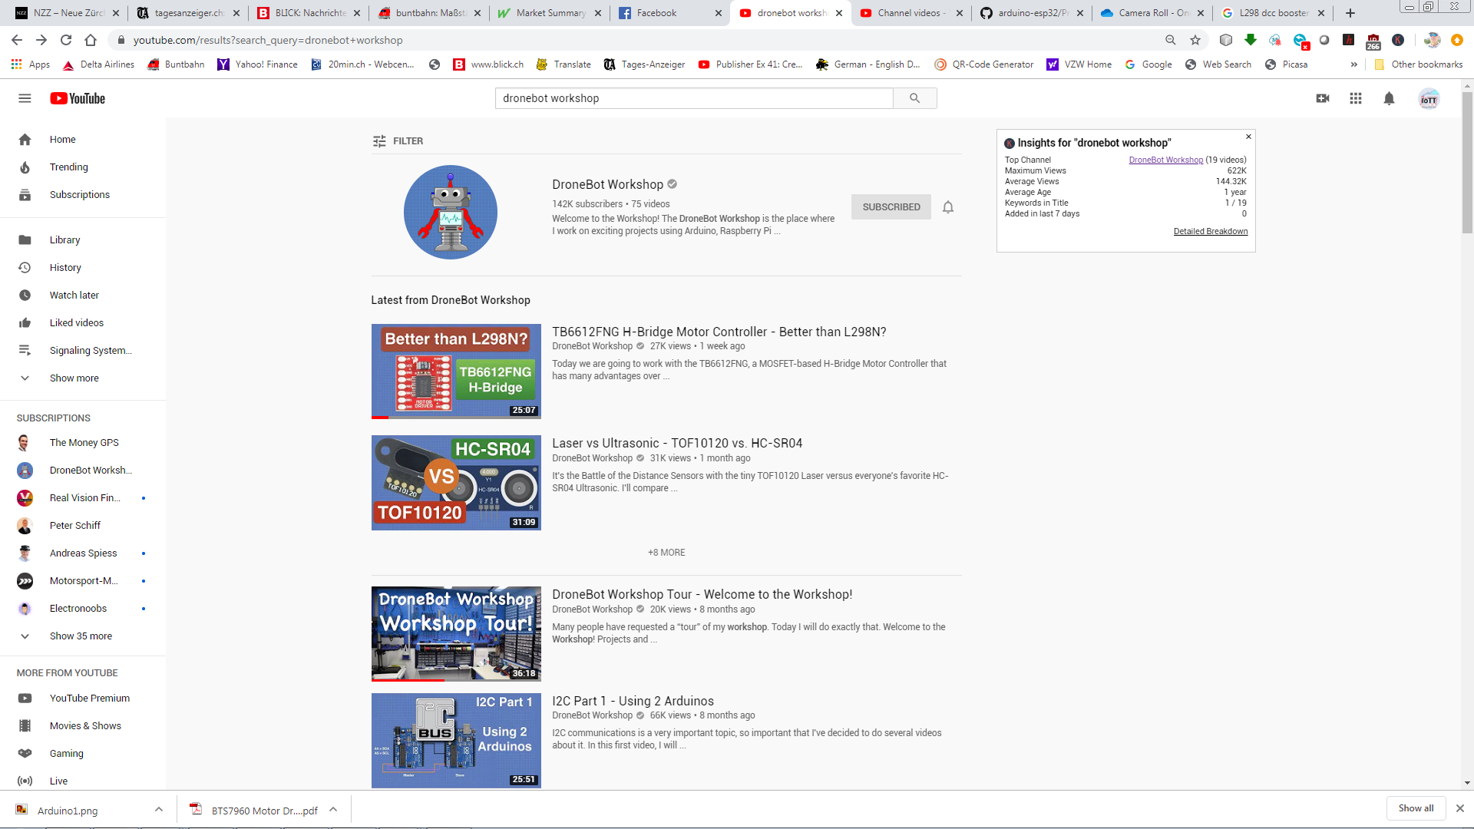
Video: https://www.youtube.com/watch?v=JPPTRj0KWbg
Article: https://dronebotworkshop.com/tb6612fng-h-bridge/

Slide 12
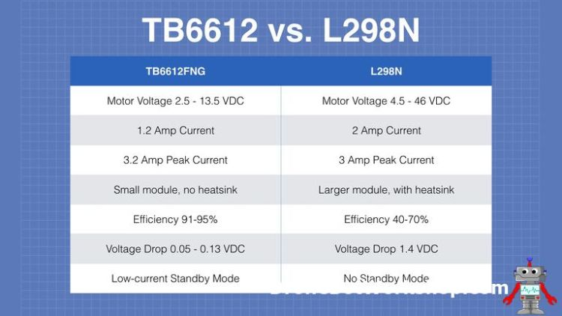
MOSFET
BIPOLAR
Video: https://www.youtube.com/watch?v=JPPTRj0KWbg
Source: https://i1.wp.com/dronebotworkshop.com/wp-content/uploads/2019/12/TB6612-vs-L298N.jpeg

Slide 13
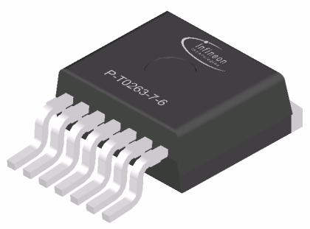
BTS 7960
High Current PN Half Bridge
43 A max Current
7 mΩ + 9 mΩ H-Bridge Resistance
Power Loss at 10 Amps: 0.9W
Power Loss at 15 Amps: 2.025W

Slide 14
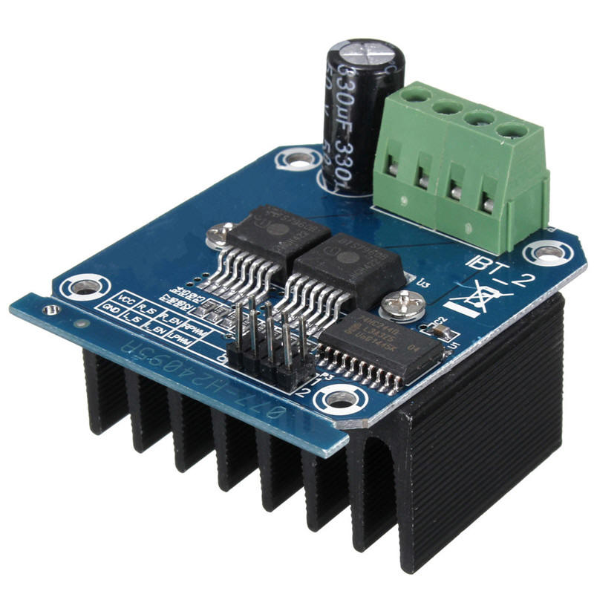
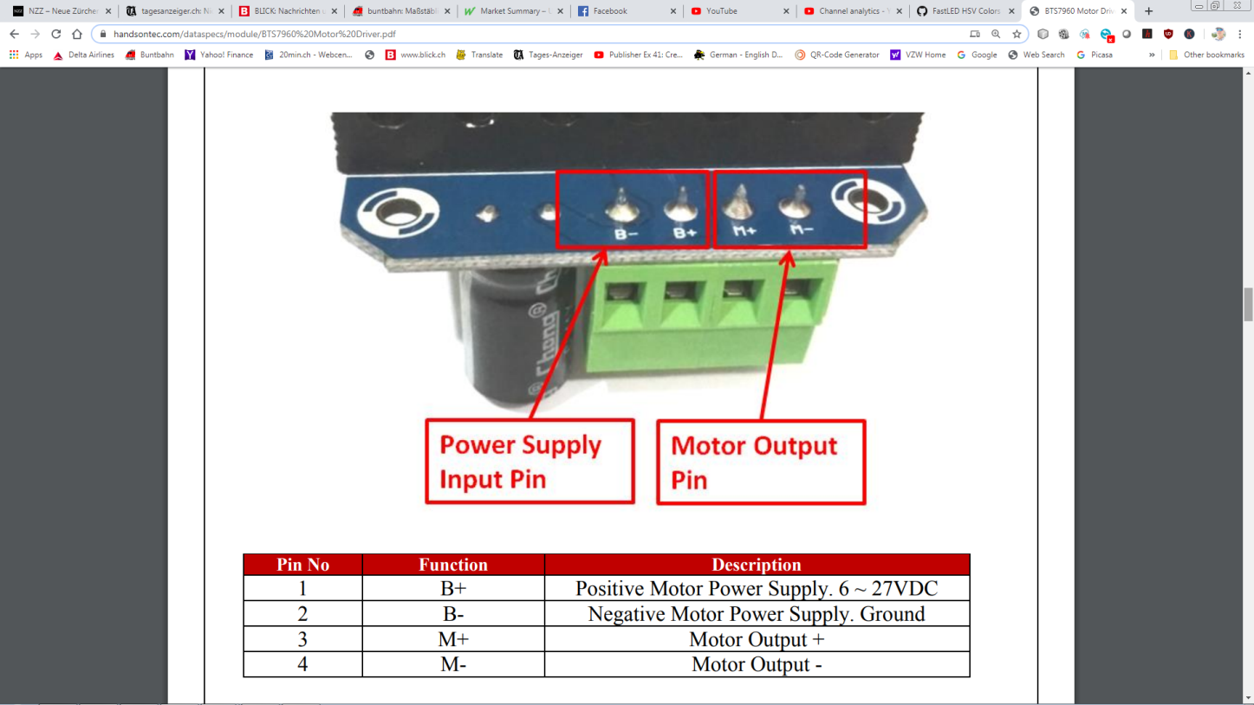
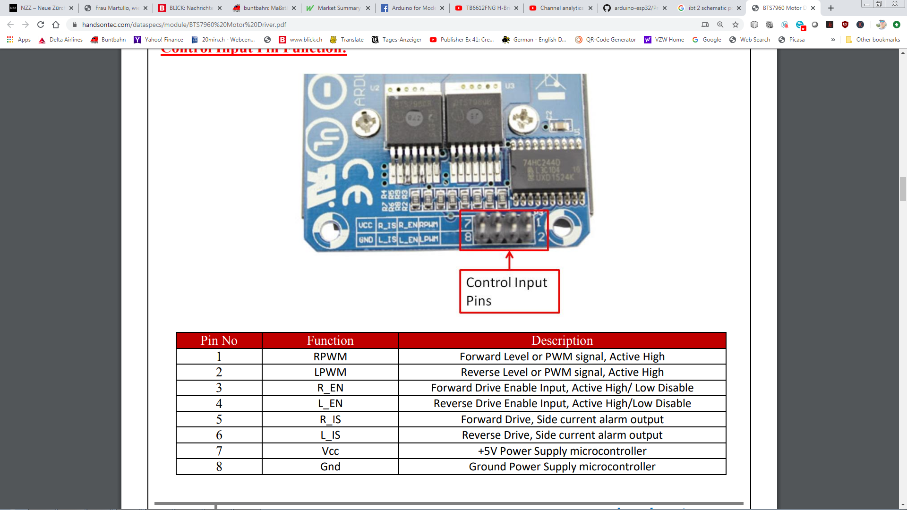
Source: https://www.handsontec.com/dataspecs/module/BTS7960%20Motor%20Driver.pdf

Slide 15
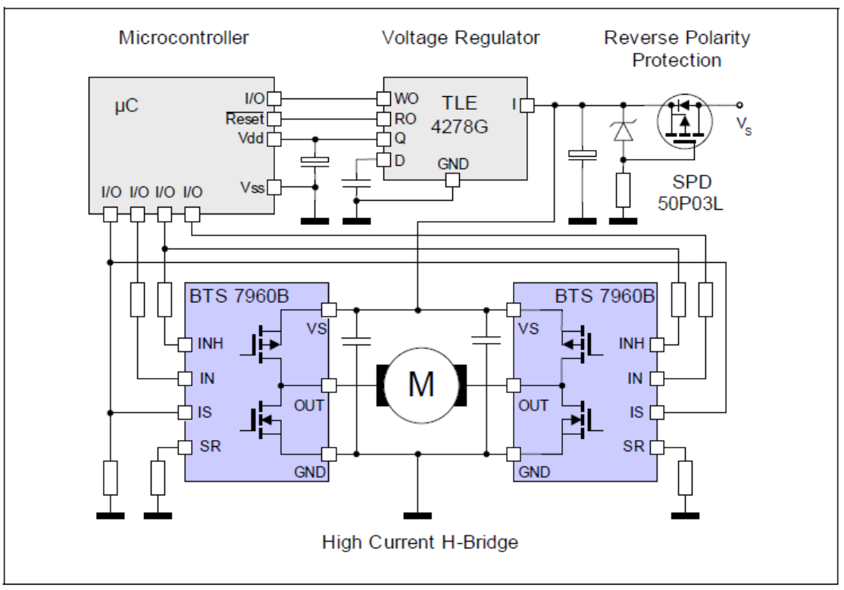
Source: https://www.handsontec.com/dataspecs/module/BTS7960%20Motor%20Driver.pdf

Slide 16
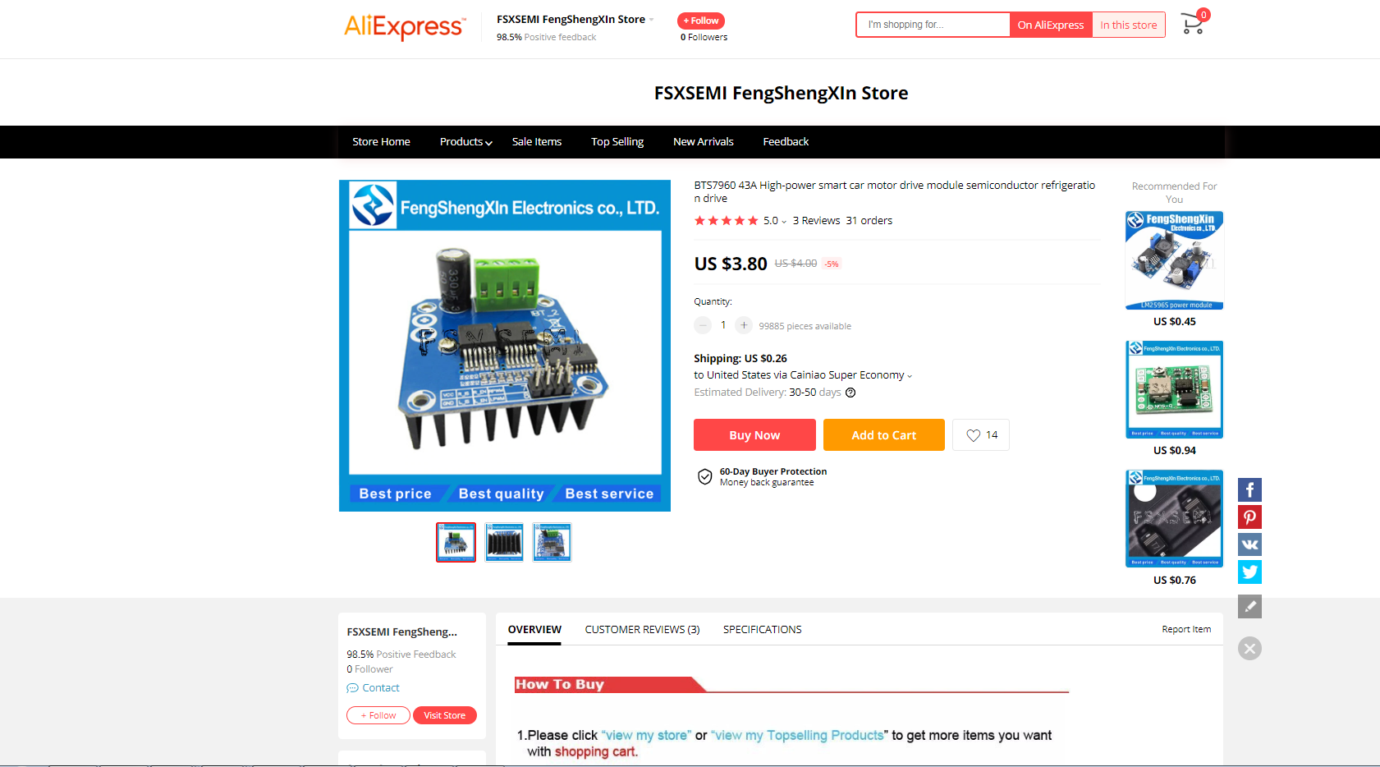

Slide 17
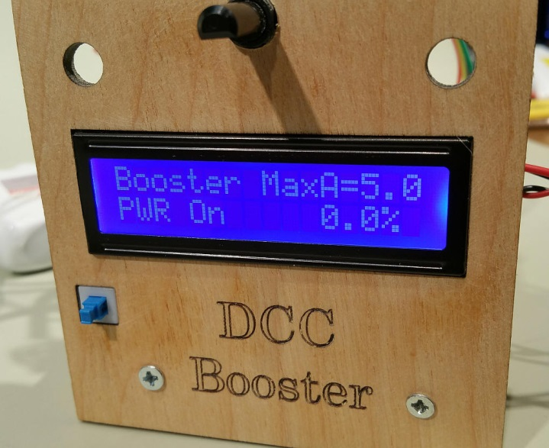
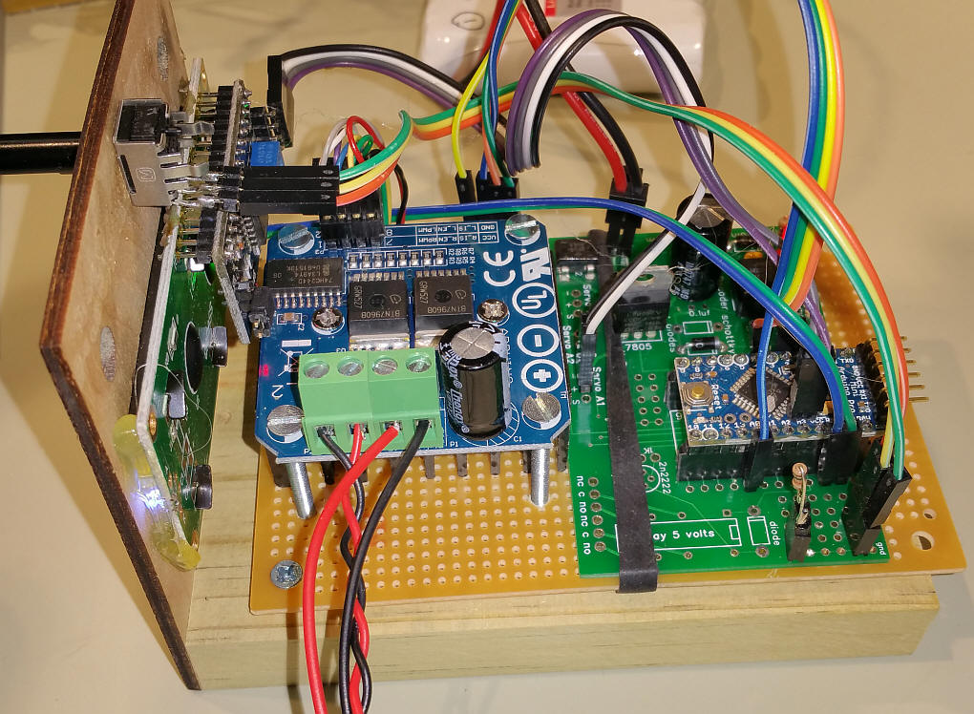
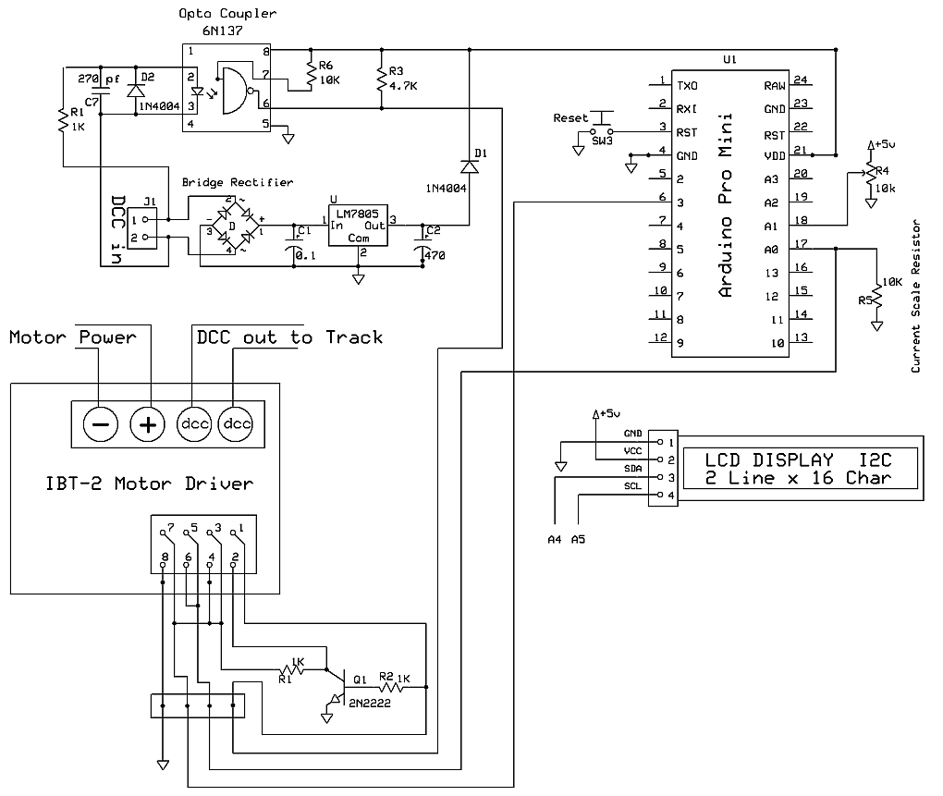
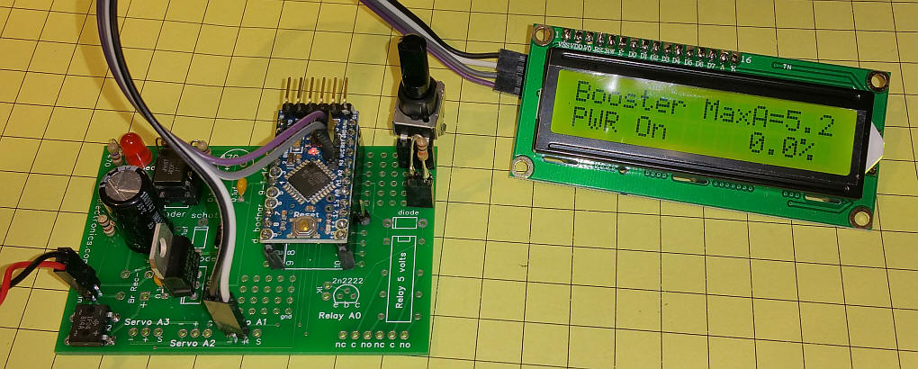
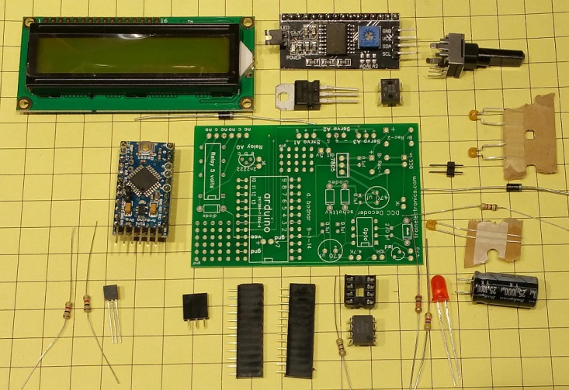
Source: http://trainelectronics.com/DCC_Arduino/DCC_Booster/index.htm

Slide 18
DCC Path
Power Path
Source: http://trainelectronics.com/DCC_Arduino/DCC_Booster/index.htm

Slide 19
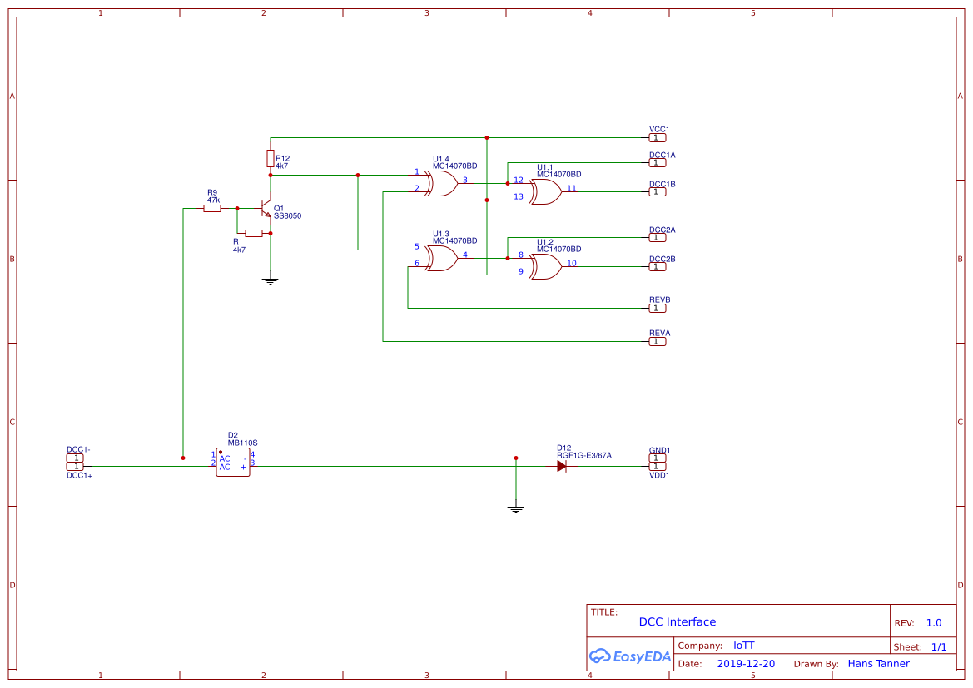
DCC Path
3.3V Inverter Voltage/Signal Pullup
DCC A/B for Booster A to BTS7960 Pins 1 + 2
DCC A/B for Booster B to BTS7960 Pins 1 + 2
Auto Reverse Booster B from ESP32
Auto Reverse Booster A from ESP32
DC Power Supply to
Buck Converter for 5V
DCC Raw Input
DCC Input
Power Path
IoTT Design Alternative

Slide 20
DCC Path
Power Path
Current Sense Input
DCC Raw Input
DCC Mirror
Source: http://trainelectronics.com/DCC_Arduino/DCC_Booster/index.htm

Slide 21
DCC Path
3.3V Inverter Voltage/Signal Pullup
DCC A/B for Booster A to BTS7960 Pins 1 + 2
DCC A/B for Booster B to BTS7960 Pins 1 + 2
Auto Reverse Booster B from ESP32
Auto Reverse Booster A from ESP32
DC Power Supply to
Buck Converter for 5V
DCC Raw Input
Quad XOR DCC Mirror + Reverse
Auto Reverse Polarity Change Inputs
DCC Input
Power Path
IoTT Design Alternative

Slide 22
DCC Path
Power Path
Current Sense Input
Current Sensor
DCC Raw Input
DCC Mirror
Source: http://trainelectronics.com/DCC_Arduino/DCC_Booster/index.htm

Slide 23
DCC Interface: Opto or Not?
3.3V Pullup Voltage
DCC Raw Input
GND
In most situations an Optocoupler is not really needed for a DCC decoder or booster

Slide 24
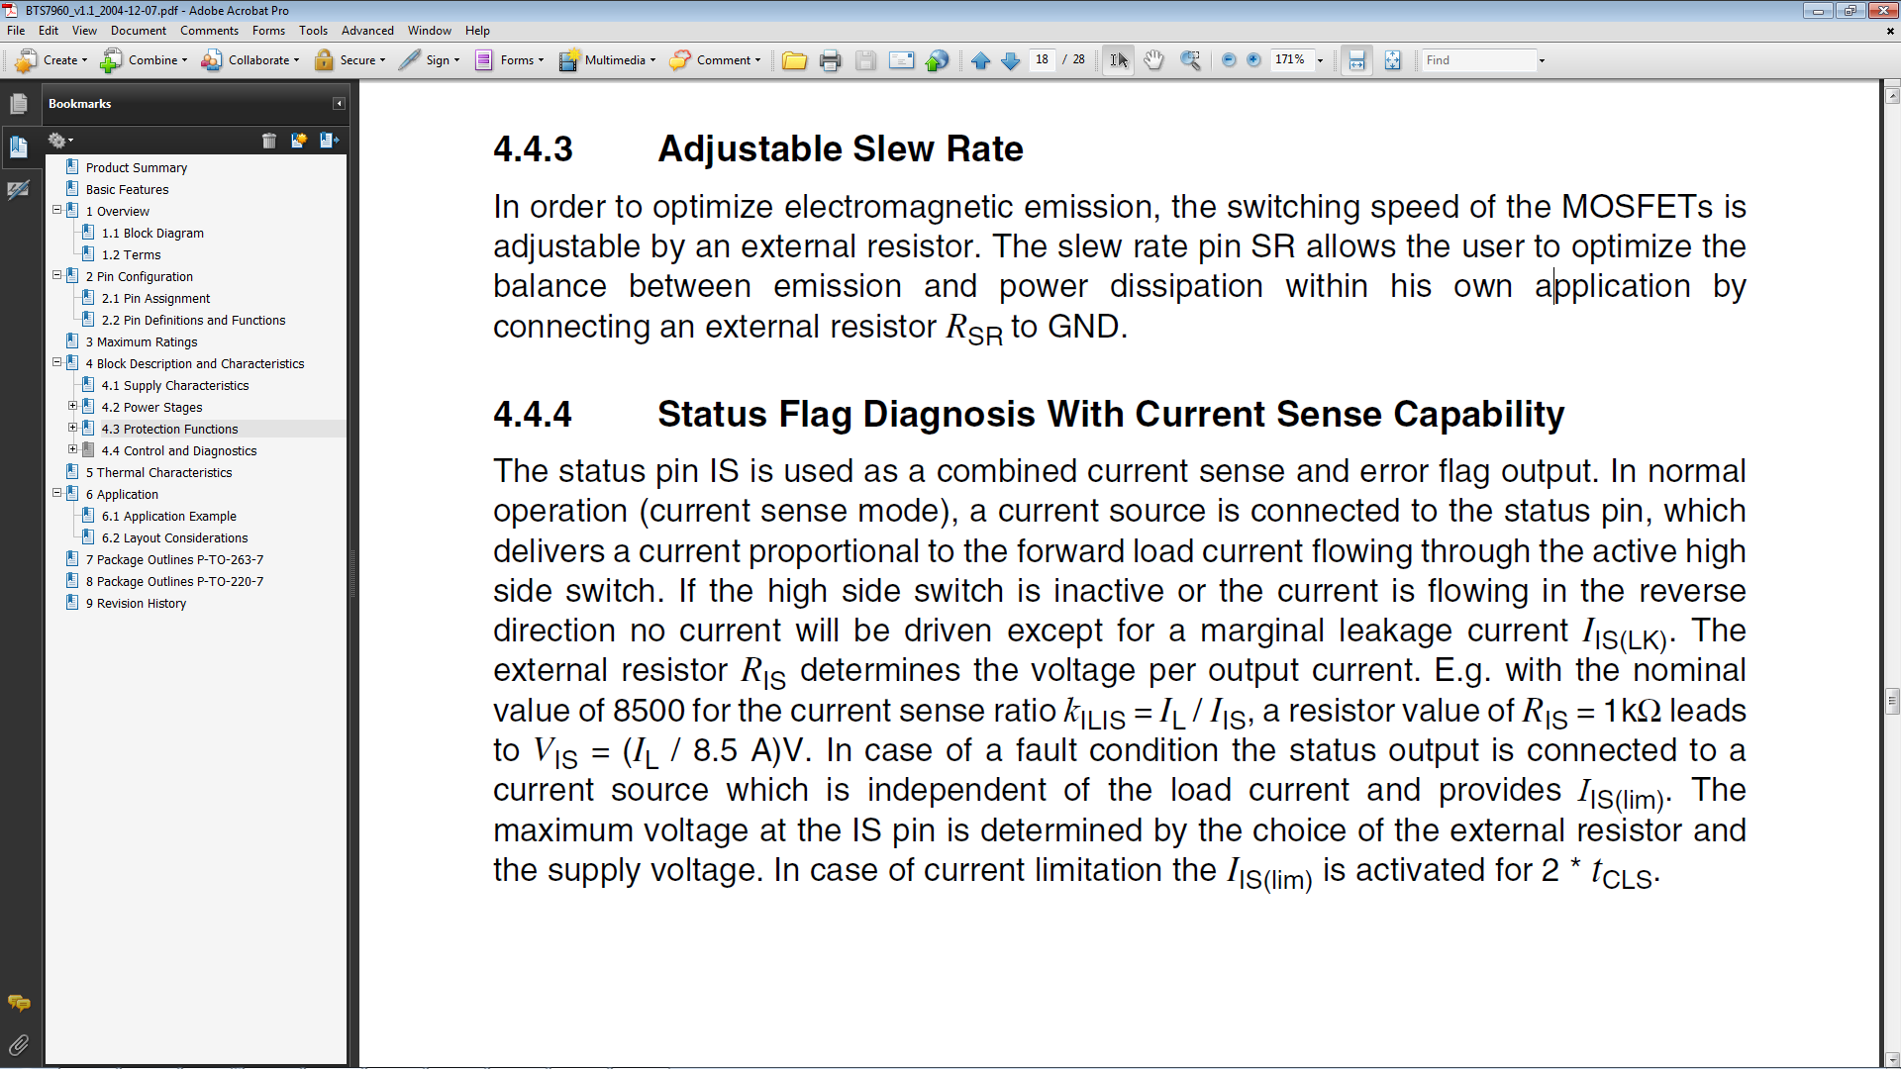
Source: BTS7960 Data Sheet Chapter 4.4

Slide 25
Current Sensing Pin
IS pin has a dual purpose: a) During normal run, current to resistor Ris is proportional to load current (actually current of high side switch). Nominal/typical scaling factor listed on the datasheet is 8500. So with 15 A current, current to resistor Ris is 15 A/8500 = 1,8 mA. If this is supplied to 500 ohm resistor, voltage to Arduino analog input is 1,8 mA*500 = 0,9 V. b) On fault condition, about 7 mA is supplied to Ris. This makes 7 mA*500 = 3,5 V on analog input.
c) Resulting resolution on 12bit ADC of ESP32 for 25A -> 4000: ~ 6mA per increment
https://forum.allaboutcircuits.com/threads/how-to-connect-h-bridge-for-its-protection-features.141724/

Slide 26
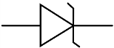
Current Sensing Pin
I/8500
R10k
On board
U_{CS}
R470
Z3.3V
U_{CS} = R_{tot} * I = I * 429.6 ῼ
I/8500
R10k
On board
100mAr -> 5.06mV -> ADC 6.28
1Ar -> 50.6mV -> ADC 62.8
1 ADC incr = 0.8mV -> 15.92mAr
Imax = 7.6mA -> 65A

Slide 27
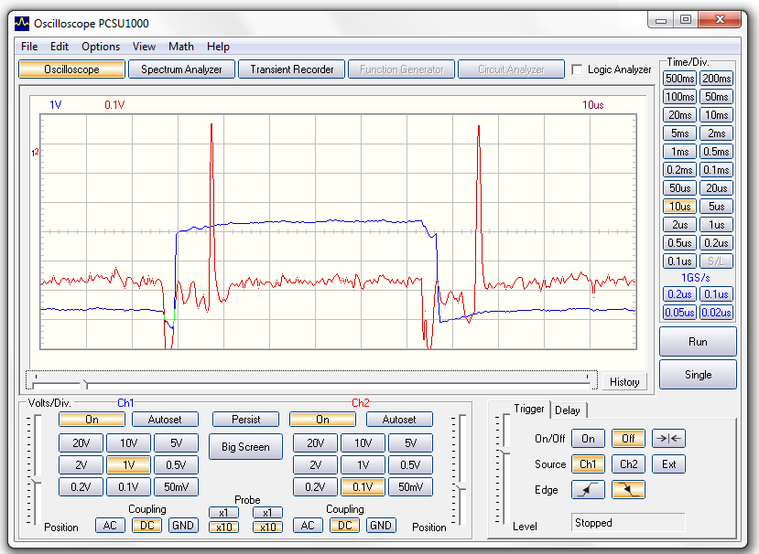
Constant Output Load
DCC One bit (first half)
DCC Input
Measuring Pin Voltage

Slide 28
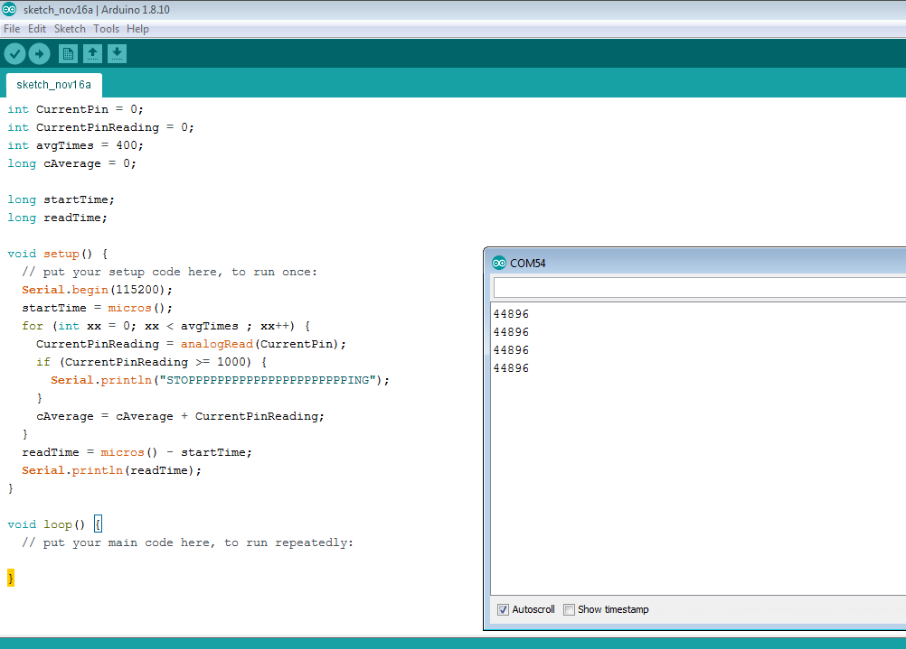
Dave Bodnar @ Trainelectronics.com uses 400 consecutive analog reads to get an average value in about 45 ms or up to 7 complete DCC messages
-> this is an extreme low pass filter using the average of 400 measurements!
Dave’s Current Measuring Loop Function
Algorithm Loop time in microseconds

Slide 29
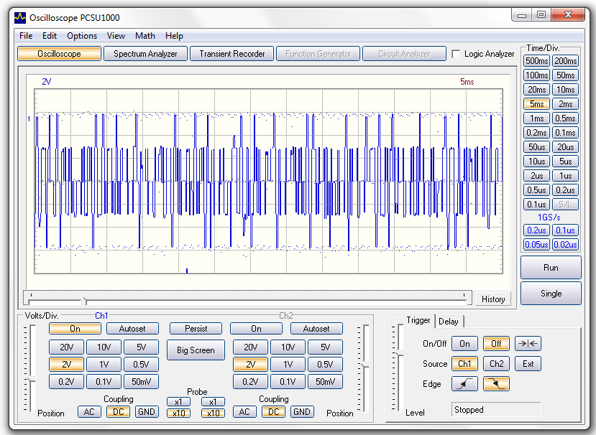
Dave Bodnar Approach:
Extreme Low Pass Filter implemented in software
DCC Data Stream
Measuring Start / End
DCC Signal and Measuring Interval 45 ms = ~ 300bits = ~ 7 DCC Messages

Slide 30
Dave Bodnar @ Trainelectronics.com uses 400 consecutive analog reads to get an average value in about 45 ms or up to 7 complete DCC messages
-> this is an extreme low pass filter using the average of 400 measurements!
-> Short Circuit detection based on one single measurement
Single Measurement Short Circuit Detection – Risky!

Slide 31
Constant Output Load
Pulse about 8μs after
Polarity change
DCC Input
Measuring Pin Voltage

Slide 32
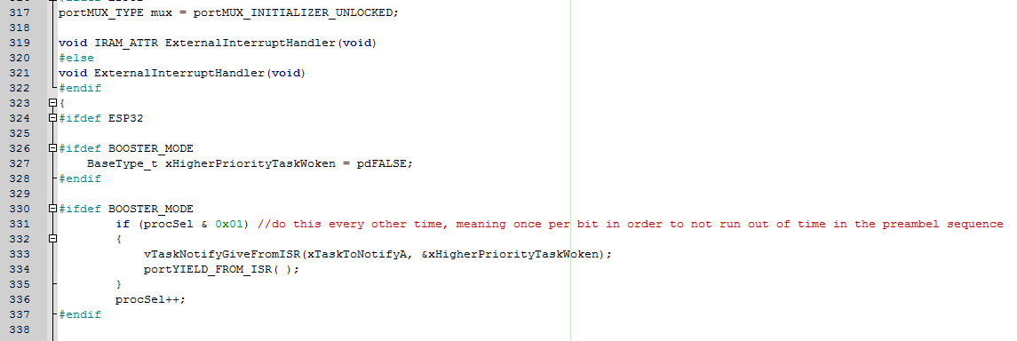
NmraDCC Modifications (1)
Step 1: Setting a flag every other time the ISR is run

Slide 33
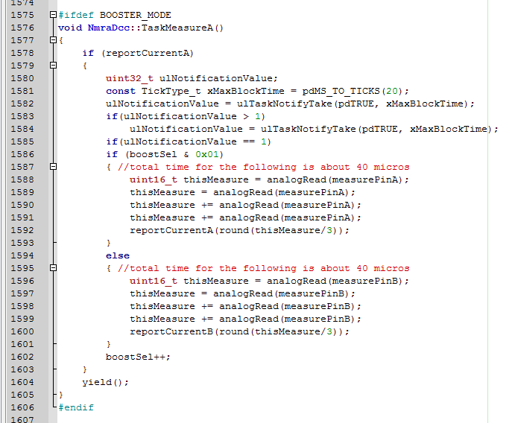
NmraDCC Modifications (2)
Step 2: Create a task that
waits for the flag and
performs 3 valid measurements in a row and
reports the average
Alternating between the two measuring pins

Slide 34
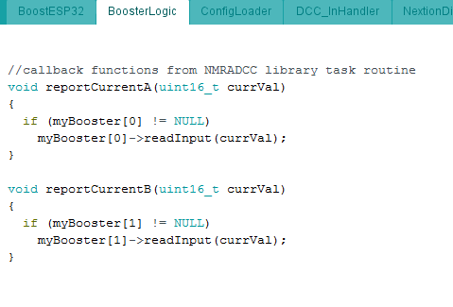
Main Sketch Callback
Step 3: Callback Function
Receives the value from NmraDCC and
Calls the input function of the Booster object

Slide 35
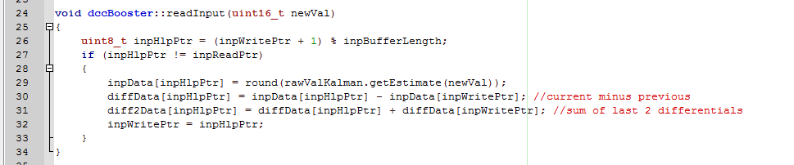
Booster Library
Step 4: Filtering and Buffering
Filter values using a Kalman Filter
Calculate the differential values to the two previous measurements (for short circuit detection)
Add new values to a FIFO buffer for the program to process

Slide 36
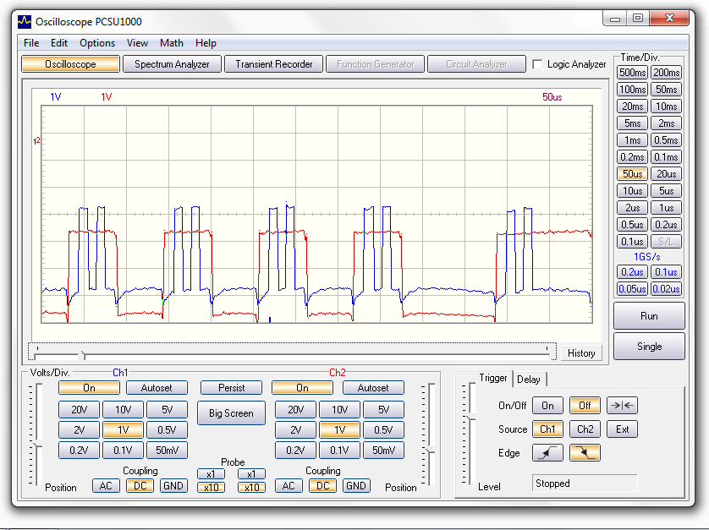
Measuring Sequence
Marker Pulses
DCC Input Signal
Measuring Points

Slide 37
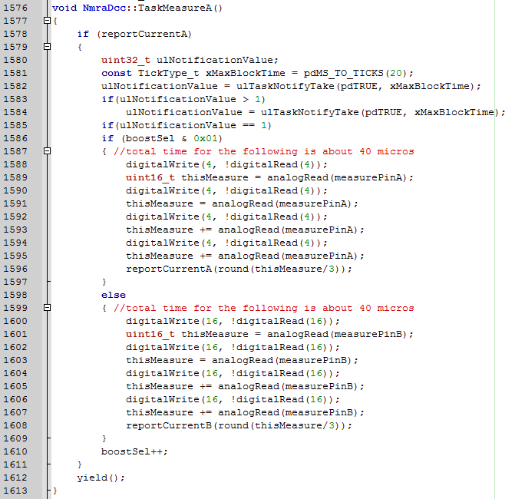
Code to mark the measuring location Booster A
Code to mark the measuring location Booster B

Slide 38

DCC Output vs Measurement
Marker Pulses
DCC Output Signal
Measuring Points

Slide 39

Current Sense vs Measurement
Marker Pulses
Current Sense Signal
Measuring Points

Slide 40
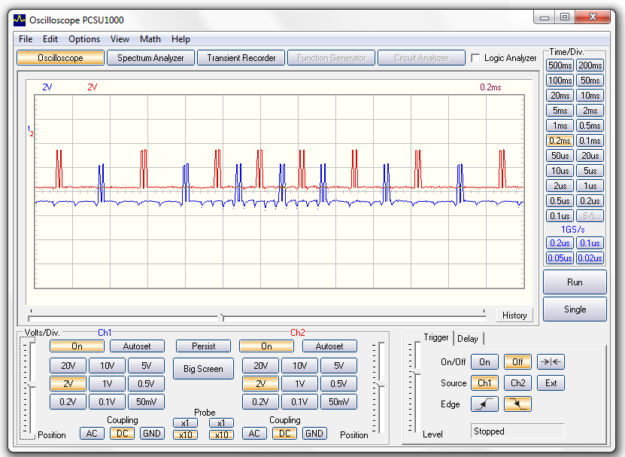
Double Channel In-Bit Analog Read for every 4th bit per channel
In-bit Measuring points Booster A
DCC 0-Bit
DCC 1-Bit
In-bit Measuring points Booster B

Slide 41
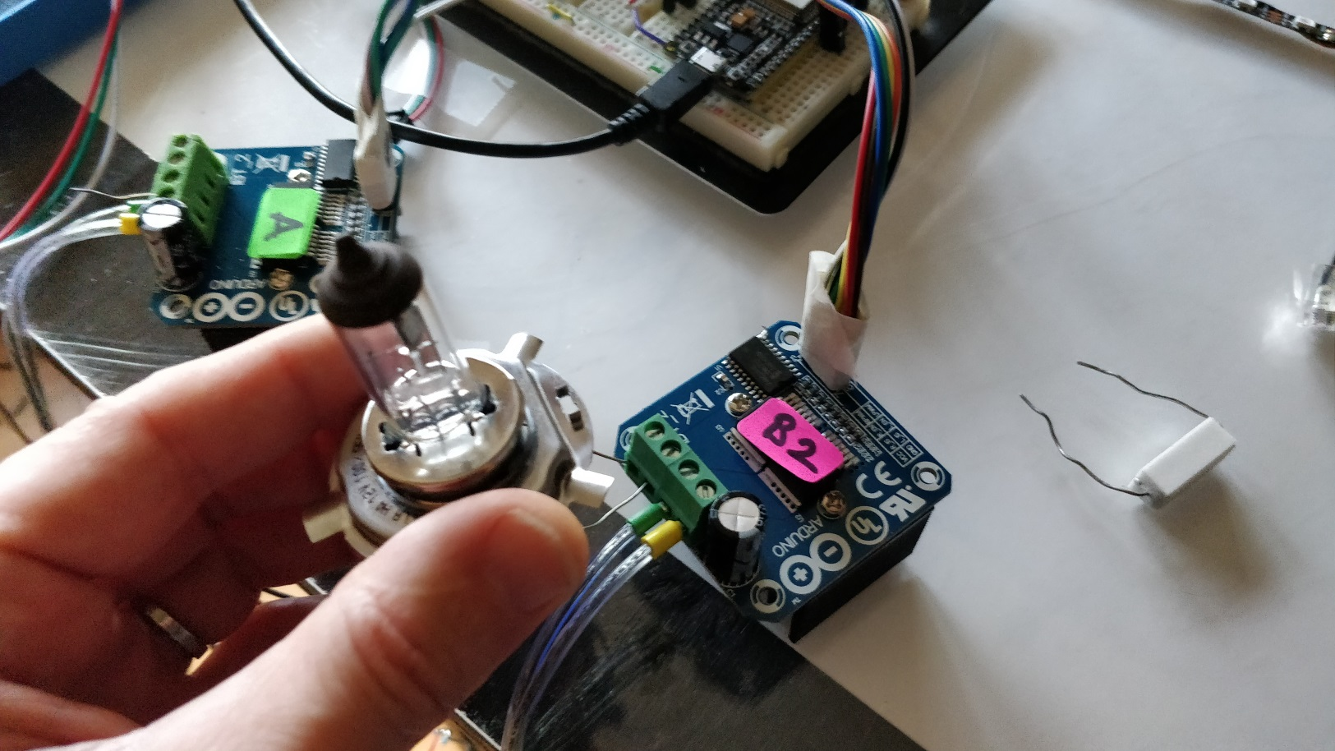
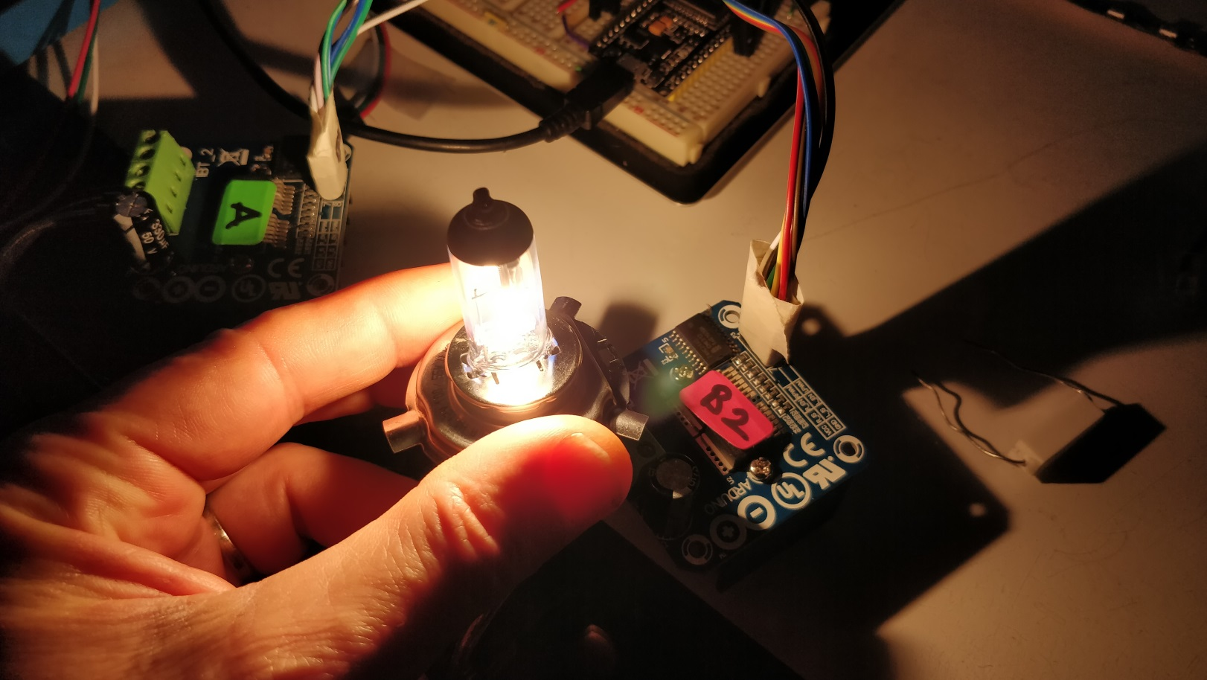

Slide 42
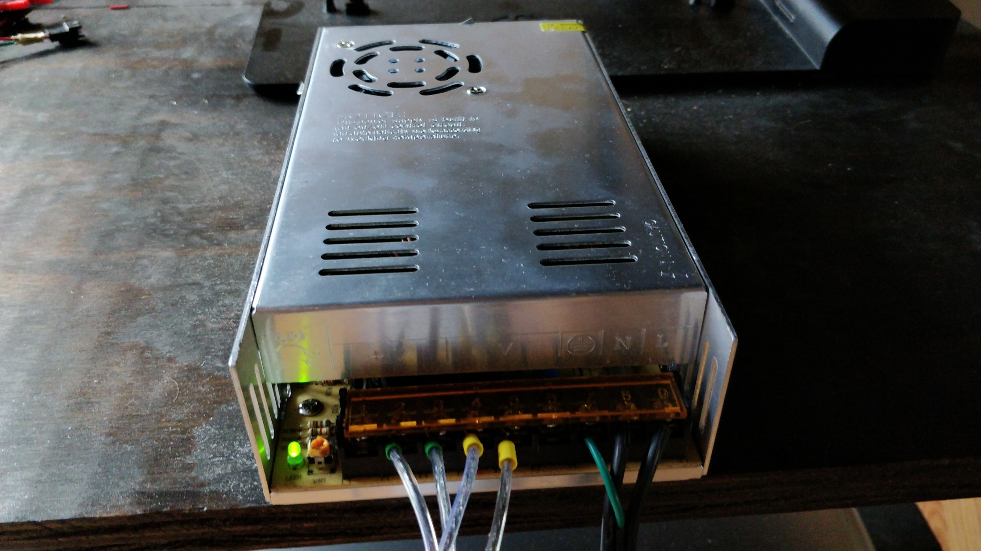

Slide 43
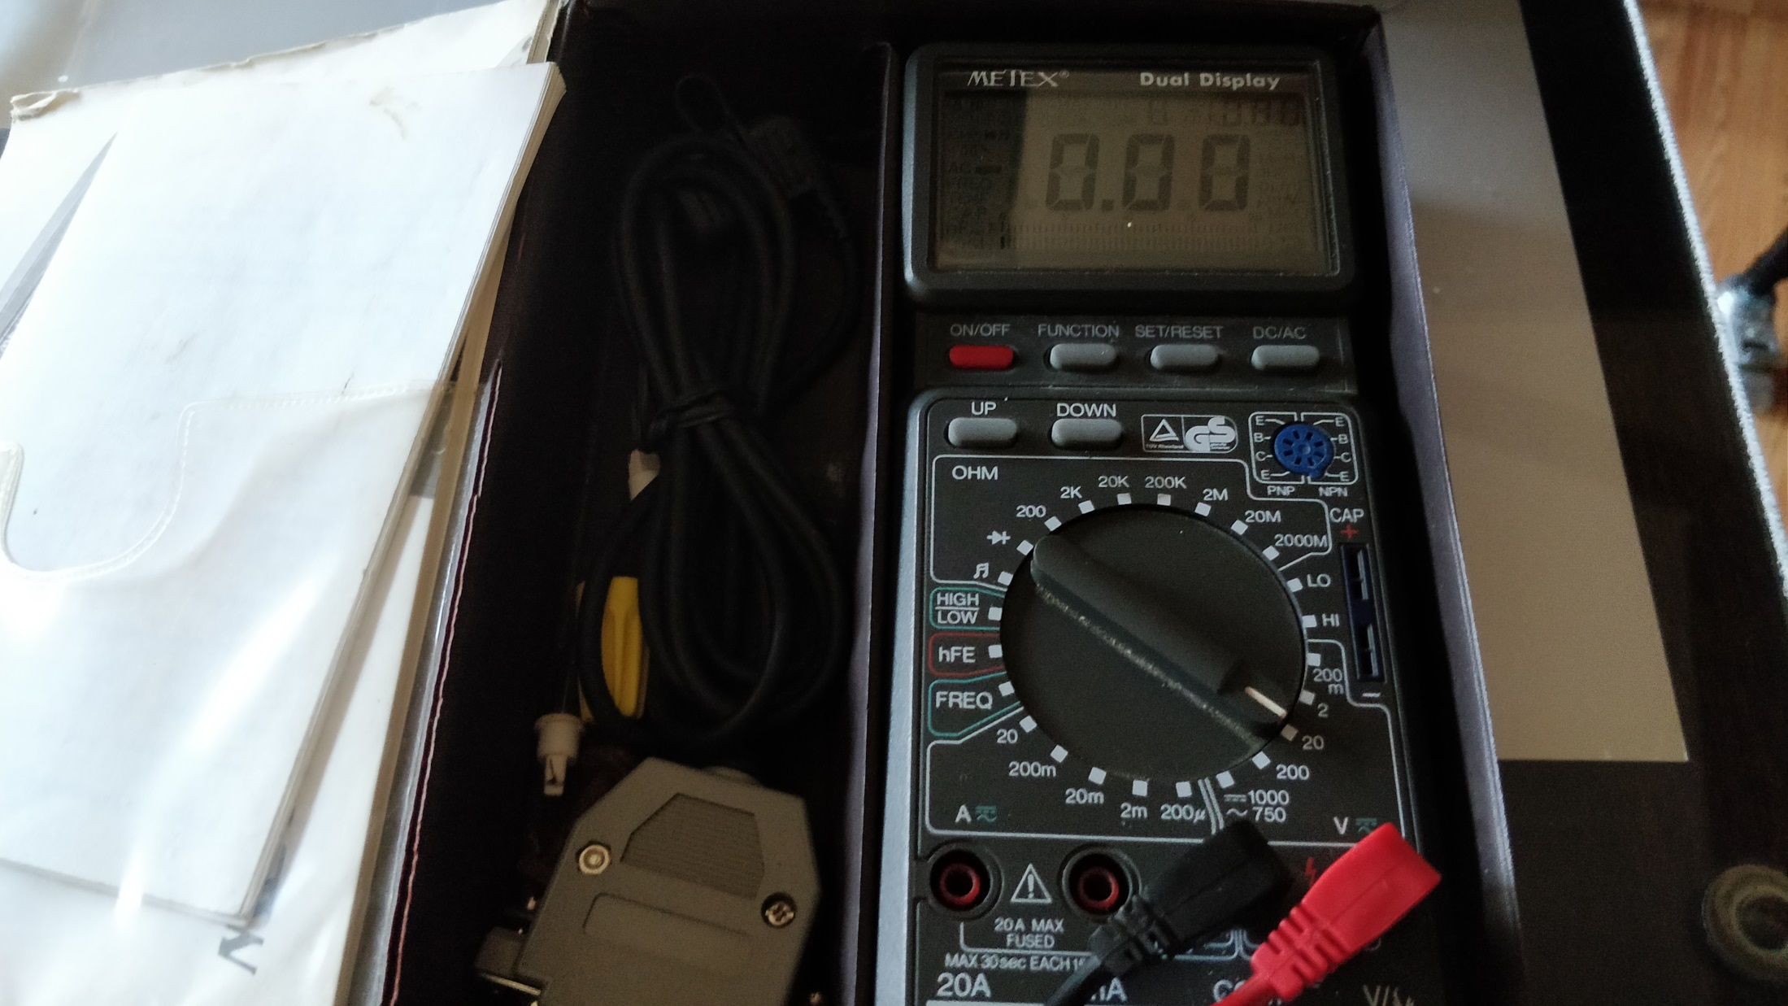

Slide 44
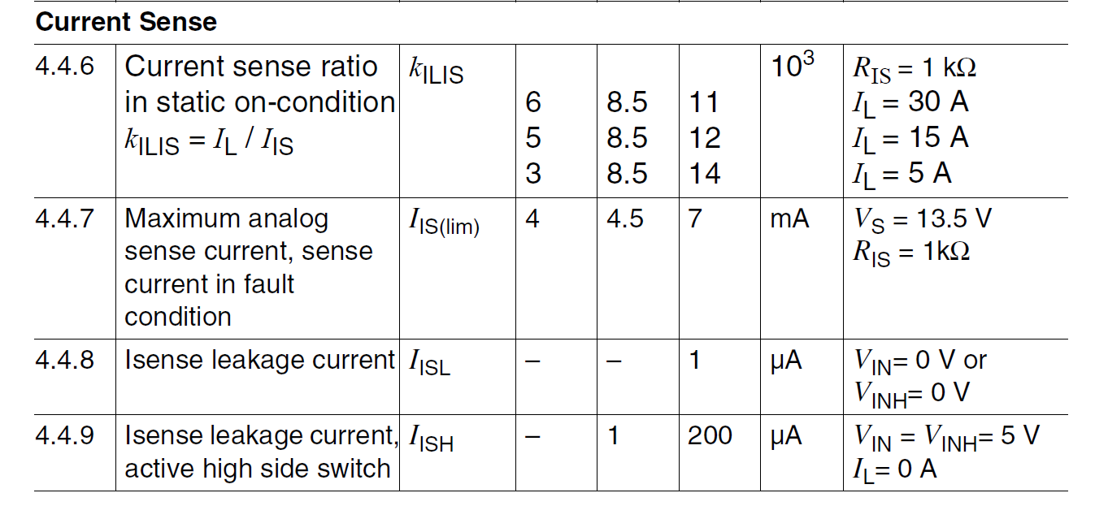
Source: BTS7960 Data Sheet Chapter 4.4

Slide 45
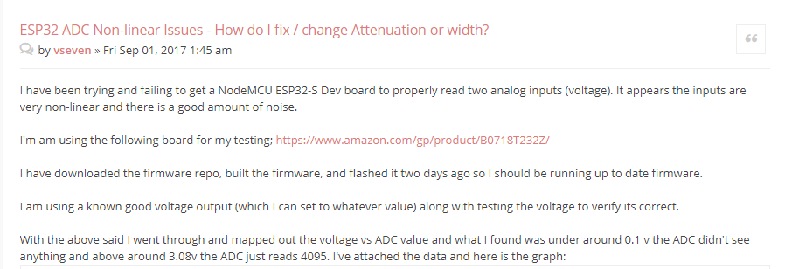
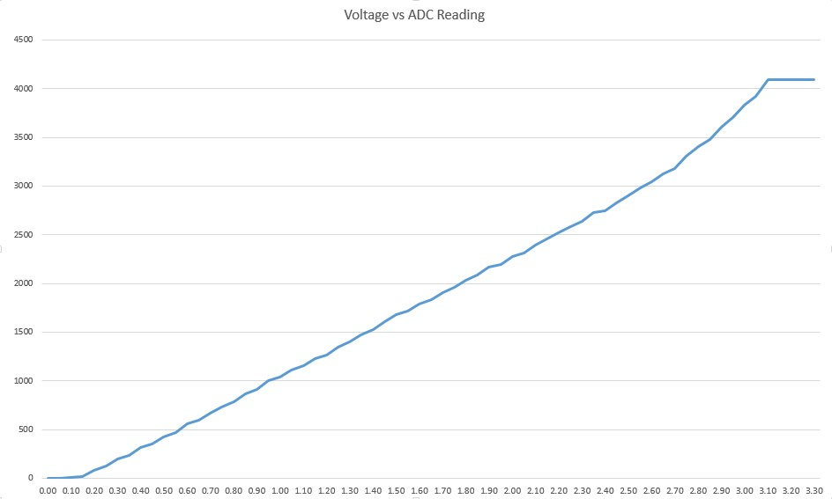
Source: https://www.esp32.com/viewtopic.php?t=2881

Slide 46
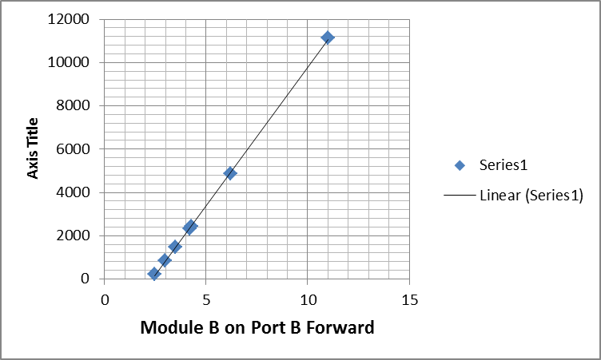
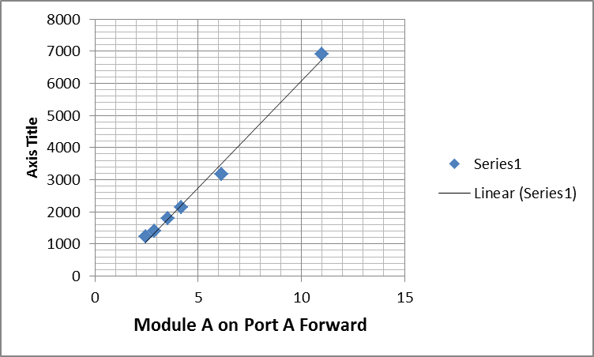
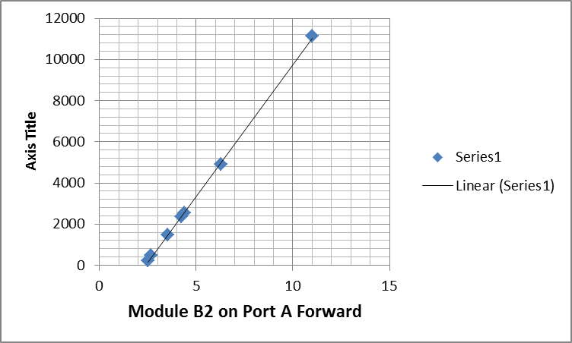
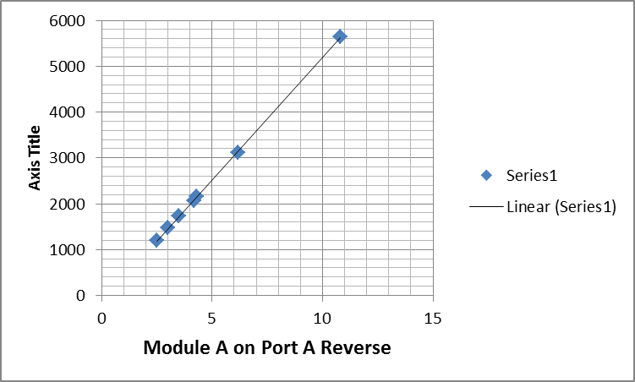
ADC Reading
ADC Reading
Amps
Amps
ADC Reading
ADC Reading
Amps
Amps

Slide 47
ADC Reading
ADC Reading
Amps
Amps
Starts at 2 Amps
Starts at 0 Amps
ADC Reading
ADC Reading
Amps
Amps

Slide 48
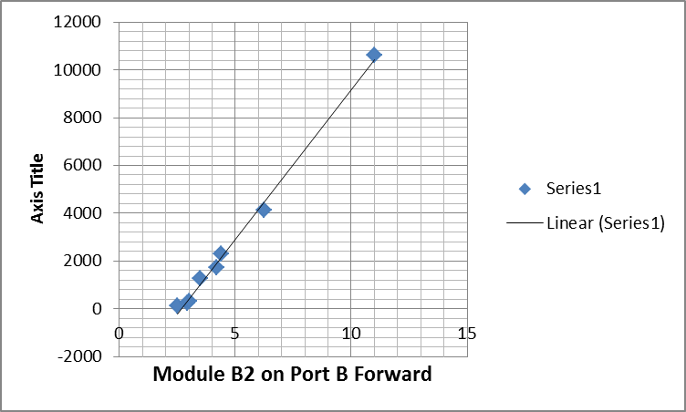
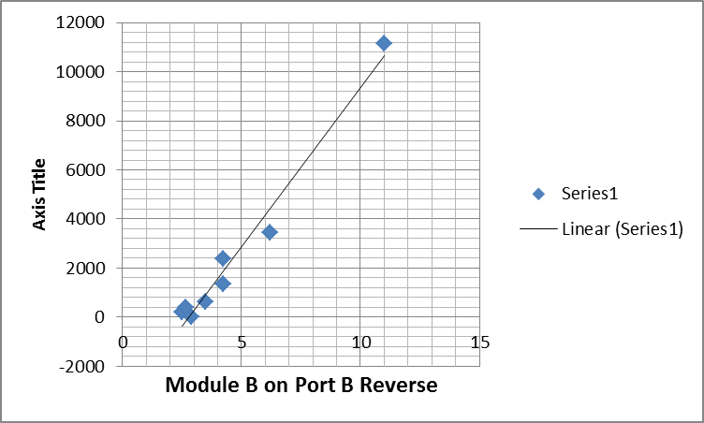

Slide 49
Booster Design Goals
2 Channels, configurable up to 15 Amps
Auto Reversing (configurable)
Overload and Short Circuit protected
Setup via Touch Screen or Wifi
Power Supply from regulated DC Source
Amplified DCC commands showing on Display (on demand)

Slide 50
Status Machine
Stress Operation
I > Imax, ΔI < Short Δ, Time < Stress Threshold
Short Circuit Operation
I > SCC, ΔI > Short Δ, Time > SC Threshold
1
3
Normal Operation, direct or reverse
I < Imax, ΔI < Short Δ
0
Overload Shutdown
I = 0, Timer < Pause Time
Short Circuit Shutdown
I = 0, Timer < Recover Time
2
5
Control Settings Variables:
Max Standard Operation Current
Extended Peak Current Max
Extended Peak Current Time/Integral
Short Circuit Trip Current
Short Circuit Trip Time delay
Reverse Mode Test Time
OverloadRecoverWaitTime
ShortCircuitRecoverWaitTime
Reverse Operation Test
I < Imax, ΔI < Short Δ, Timer < Timeout
Missing DCC Shutdown
Waiting for DCC Signal
4
6

Slide 51
Summary
Bipolar H-Bridge drivers are significantly less efficient than FET based ones
Using an Opto-Coupler to separate power and information of a DCC signal is possible, but normally not necessary
The primary use case for an H-Bridge is amplifying a PWM output to drive a motor, not amplifying a DCC signal
The current sense pin provides a proportional current source, but there are some non-linear effects to it when polarity of the bridge changes
In order to get good current measurements, the measuring points should be synchronized with the DCC signal

Slide 52
IBT-2 User Guide: https://www.handsontec.com/dataspecs/module/BTS7960%20Motor%20Driver.pdf
BTS7960 Datasheet: https://www.infineon.com/dgdl/BTS7960_Datasheet.pdf?folderId=db3a304412b407950112b408e8c90004&fileId=db3a304412b407950112b43945006d5d
DroneBot Comparison: https://www.youtube.com/watch?v=JPPTRj0KWbg
DroneBot Article Source: https://i1.wp.com/dronebotworkshop.com/wp-content/uploads/2019/12/TB6612-vs-L298N.jpeg
Dave Bodnar’s Booster: http://trainelectronics.com/DCC_Arduino/DCC_Booster/index.htm

Slide 53




IoTT
Internet of Toy Trains

